Slide 1
Investment AI Model
AI-Driven Investment Research & Asset Allocation Platform

Slide 2
Project Vision
Build an intelligent, automated investment research system
Combine:
Quantitative asset allocation
Market sentiment intelligence
AI-driven macroeconomic analysis
Transform raw financial data into actionable strategy

Slide 3


Strategic Positioning
Positioned as a:
Research decision engine
ETF & portfolio optimization platform
AI-powered macro & sentiment intelligence system

Slide 4
Target Users
Positioned as a:
Investment research team
Strategy & allocation team
Portfolio managers
Fintech product & data teams

Slide 5
Core Goal “Reduce human research cost, accelerate decision speed, and improve investment intelligence quality through AI.”
Status
Internal research & prototype stage
Tech Stack
React + Node + Python + Google Gemini AI

Slide 6
Business Problems in Traditional Investment Research.

Slide 7
Information Overload & Signal Noise
Investors face:
Massive volumes of news
Social media sentiment
Macro data releases
Key risks:
Important signals buried under noise
Delayed reaction to market turning points

Slide 8
Lack of Unified Decision Framework
Today’s workflow is fragmented:
Portfolio models in one system
Sentiment analysis in another
Macro research in reports
No single, integrated decision engine that connects:
Allocation + Sentiment + Macro + Risk

Slide 9

Core Pain Point Summary
“The industry lacks a low-cost, real-time, AI-driven system that unifies portfolio allocation, market sentiment, and macro intelligence into one decision framework.”

Slide 10
Core Product Capabilities
1️⃣ Intelligent Asset Allocation Engine
Users can:
Select target assets (e.g., QQQ, SPY, GLD)
Define investment horizon & total capital
System automatically computes:
✅ Asset weight (%)
✅ Capital allocation (currency-based)
✅ Visual portfolio distribution (charts)

Slide 11
Core Product Capabilities
Supports:
Strategic allocation planning
Scenario simulation
Portfolio rebalancing reference

Slide 12
Core Product Capabilities
2️⃣ AI-Driven Market Sentiment Analysis
Automatically generates:
✅ Market sentiment summary
✅ Bullish & bearish factor breakdown
✅ Macro-driven narrative explanation
Covers:
News
Social discussion
Market psychology

Slide 13
Core Product Capabilities
Multiple intelligence modes:
Neutral
Popular (retail sentiment)
Professional (institutional perspective)

Slide 14
Core Product Capabilities
3️⃣ Macro & Theme Intelligence Extraction
Detects major market drivers:
AI technology cycle
Federal Reserve policy
Inflation & interest rate trends
Corporate earnings momentum
Translates macro events into:
Investment implications
Portfolio-level strategy impact

Slide 15
Core Product Capabilities
4️⃣ Fully Interactive Visualization Dashboard
Real-time dashboards include:
Allocation tables
Dynamic pie charts
Asset-specific AI analysis views
Multi-language support:
English
Traditional Chinese
Japanese

Slide 16
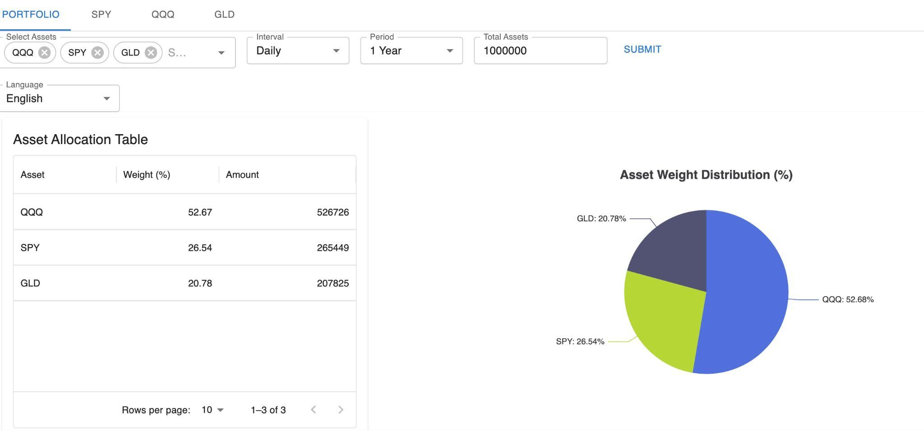

Slide 17

Portfolio Allocation Dashboard
Users select:
Target assets (e.g., QQQ, SPY, GLD)
Time interval & horizon
Total investment capital
System outputs instantly:
✅ Asset weight (%)
✅ Capital allocation (currency)
✅ Visual pie chart distribution
Enables:
Portfolio simulation
Allocation comparison
Risk dispersion awareness

Slide 18
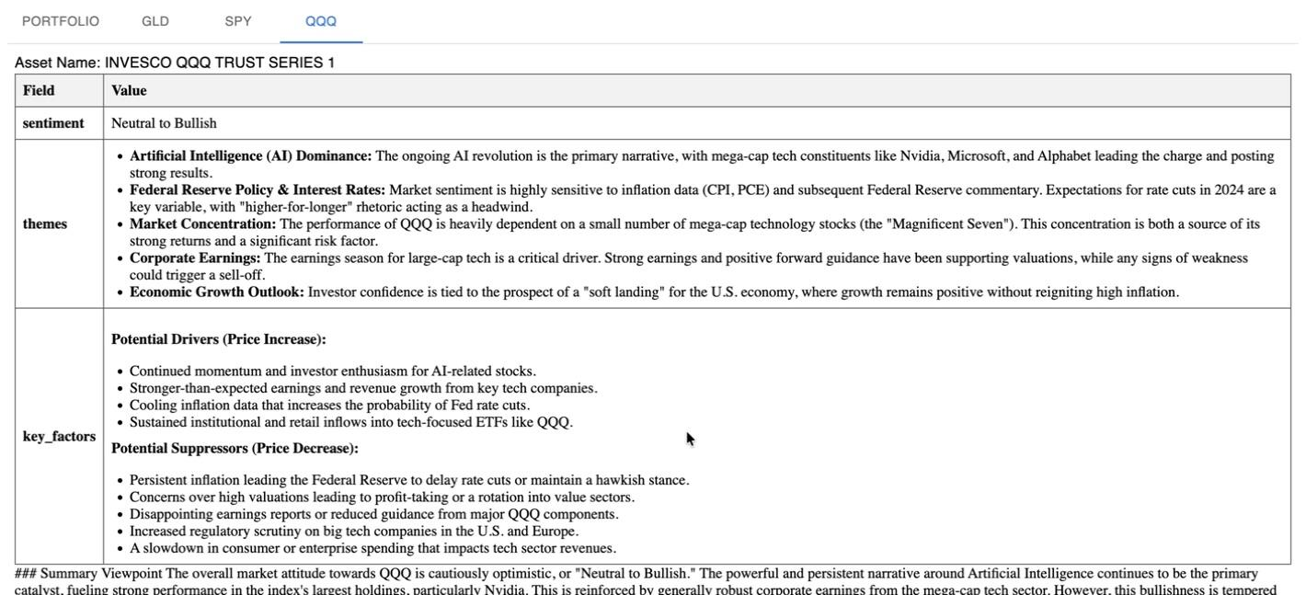

Slide 19
AI Asset-Level Analysis (QQQ Example)
Displays:
AI-generated market sentiment
Core investment themes
Key bullish & bearish drivers
Bridges:
Quant allocation
With qualitative market reasoning

Slide 20
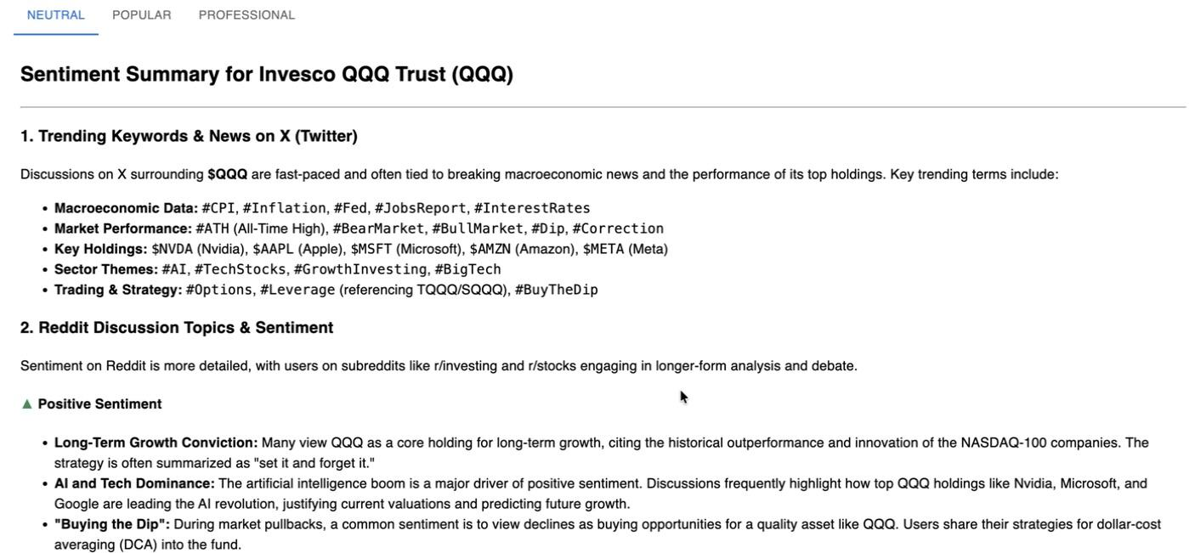

Slide 21
AI Sentiment Intelligence View
Three intelligence layers:
✅ Neutral – balanced market interpretation
✅ Popular – retail investor & social-driven narrative
✅ Professional – institution-style macro logic
Helps decision-makers:
Compare emotional vs rational market forces
Identify crowd behavior vs smart capital logic

Slide 22

Key Executive Takeaway
This is not a static dashboard — it is a living, AI-augmented investment decision platform.
.

Slide 23
System Architecture – Modular & Scalable Design
┌────────────────────────────┐
│ Frontend UI │
│ React + TypeScript │
│ Multi-language Dashboard │
└─────────────▲──────────────┘
│ HTTP API
┌─────────────┴──────────────┐
│ Node.js API │
│ TypeScript + RxJS + Inversify │
│ Business Logic & Bridge │
└─────────────▲──────────────┘
│ HTTP Bridge
┌─────────────┴──────────────┐
│ Python Flask AI Service │
│ Google Gemini LLM Engine │
│ AI Inference & Analysis │
└────────────────────────────┘

Slide 24
Layer Responsibilities
✅ Frontend (React)
Asset selection & portfolio input
Allocation table & charts
AI sentiment visualization
Multi-language user interaction
✅ Node API Layer (TypeScript)
Central business logic controller
Asset allocation computation
AI request management
Secure bridge between UI & AI service
✅ Python AI Microservice (Flask)
Dedicated AI inference layer
Hosts Gemini large language models
Handles: Sentiment generation
Macro analysis
Professional financial narrative

Slide 25

Architecture Advantages
✅ Clean separation of concerns
✅ Independent scaling of AI workloads
✅ Frontend remains lightweight & fast
✅ AI provider can be swapped without touching the UI
✅ Enterprise-ready microservice design
Strategic Technical Message for Management
“This architecture is designed for future enterprise deployment and large-scale AI integration — not a one-off prototype.”

Slide 26
Direct Business Value
💰 1️⃣ Significant Reduction in Research Cost
AI automates:
Market scanning
News synthesis
Sentiment extraction
Macro narrative interpretation
Reduces dependency on:
Manual analyst reporting
Repetitive market monitoring
Estimated impact:
50–70% reduction in routine research workload

Slide 27
Direct Business Value
⚡ 2️⃣ Faster Decision-Making Cycle
Traditional workflow:
Data → Analysis → Report → Decision (days)
INVEST_MODEL workflow:
Data → AI → Strategy (minutes)
Enables:
Faster market response
Earlier signal detection
Better timing for entry & exit

Slide 28
Direct Business Value
📈 3️⃣ Improved Investment Quality & Risk Awareness
Unified system connects:
Allocation
Sentiment
Macro logic
Avoids:
Emotion-driven decisions
Isolated analysis bias
Supports:
More stable portfolio construction
Better downside risk awareness

Slide 29
Strategic ROI Potential
🧠 4️⃣ Platformization Potential
Can evolve into:
Internal quantitative decision engine
Research-as-a-Service platform
Institutional AI research dashboard
Future revenue paths:
Internal productivity multiplier
External SaaS licensing
Proprietary AI investment tools

Slide 30
Strategic ROI Potential
🏦 5️⃣ Fintech & Institutional Application Potential
Applicable to:
Asset management
Wealth management
Family offices
Research firms
Bridges:
Quant modeling
AI narrative reasoning
Portfolio strategy automation

Slide 31
Executive Value Summary
INVEST MODEL is not just a technical system — it is a potential strategic asset that can reduce cost, improve decision quality, and open future fintech revenue channels.”
.

Slide 32
Future Strategic Goal of INVEST MODEL
🎯 Goal 1 — Build a Spring + Database Based Core Data Platform
Purpose: Establish a long-term trusted financial data foundation
Develop a Spring Boot + Database backend service
Core responsibilities:
✅ Store public market data
✅ Cache public API responses
✅ Preserve historical asset prices
✅ Preserve macro & public economic indicators

Slide 33
Future Strategic Goal of INVEST MODEL
🎯 Goal 2 — Deep Fusion of Quant + AI + Macro Intelligence
Purpose: Move from analysis → to decision intelligence
Fully integrate:
✅ Historical asset allocation engine
✅ AI-generated market sentiment
✅ Macro & policy indicators
Unified output through:
✅ Gemini AI professional reasoning layer
✅ Strategy-level investment conclusions
Target capability: “Let the system reason across history, emotion, macro forces, and risk — and produce actionable financial decisions.”

Slide 34
Strategic Direction Summary
The future version of INVEST_MODEL will evolve from a research tool into a full AI-powered financial decision engine built on persistent data, quant logic, and macro intelligence.”
.

Slide 35
Key Risks & Constraints
Current system relies on:
Public APIs
External data sources
Risk:
API limits
Data instability
Long-term continuity uncertainty
Mitigation:
Planned Spring + Database persistent data layer

Slide 36
Key Risks & Constraints
⚠️ 2️⃣ AI Cost & Scalability Risk
Large Language Models introduce:
Inference cost
Latency under high load
Mitigation:
Multi-model routing (Flash vs Pro)
Future caching & strategy reuse

Slide 37
Key Risks & Constraints
⚠️ 3️⃣ Regulatory & Compliance Risk
Financial AI systems involve:
Data compliance
Usage boundaries
Mitigation:
Internal research-first deployment
No direct automated trading at this stage

Slide 38
Final Executive Message
INVEST MODEL is positioned as a long-term AI-driven financial decision infrastructure — not just a prototype.”
.

